Slide 1

Train robot to climb stairs
21_22-J 34

Slide 2

Team Members
Supervisor: Mr. Samantha Rajapaksha
Co Supervisor: Mr. Buddika Harshanath
Student Name | Student ID
Jayawardana J.T.H | IT18216974
Dilshan H.V.V | IT18217100
Wijethilaka R.G.K.H | IT18220834
Balasooriya T.D | IT18212150

Slide 3

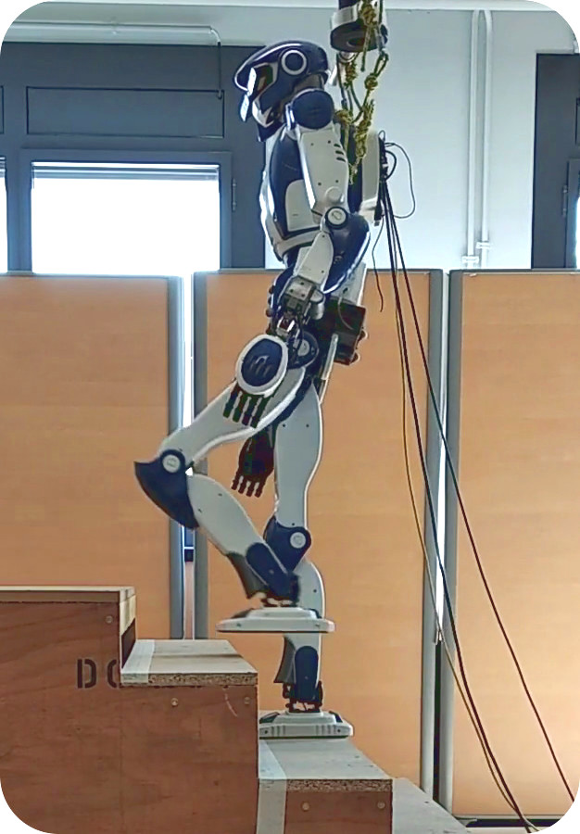
Introduction
Our research focus is to train robot to climb staircase as a human.
This Photo by Unknown Author is licensed under CC BY

Slide 4
Research Problem
When climb stairs
How to detect staircases accurately?
How to get dimensions of steps correctly?
How to move robot’s legs?
How to maintain robot’s body balance?
How to continue safe, speed and smooth move?

Slide 5
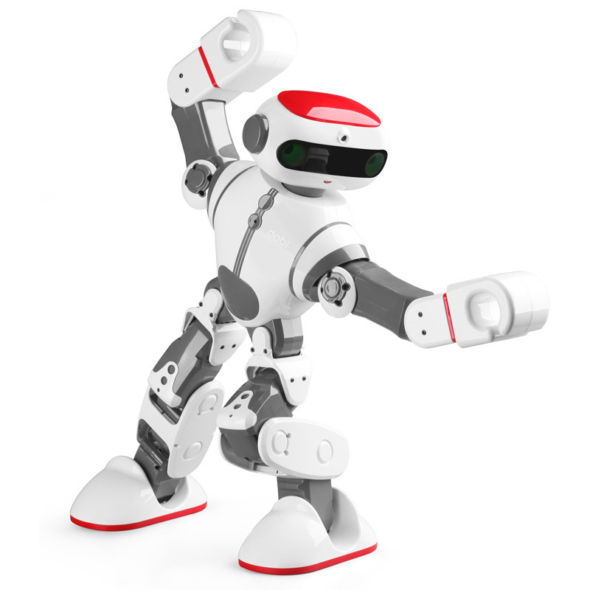
Research Objectives
Main Objective
Train robot to climb stairs.
Sub Objectives
Detect the staircase.
Get dimensions of staircase.
Move robot’s legs on the staircase.
Maintain stability of robot.

Slide 6
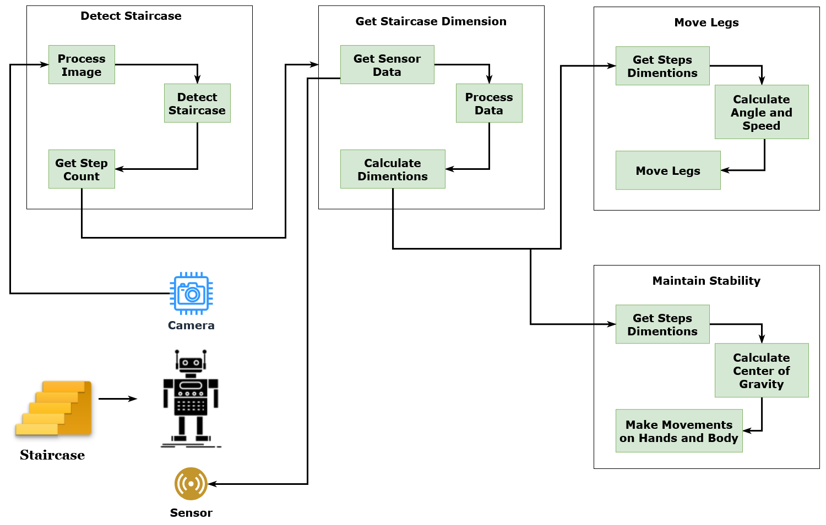
Overall System Diagram

Slide 7

IT18216974 | Jayawardana J.T.H
Specialization in Software Engineering

Slide 8
Research Question
How to detect staircases accurately?
How to identify low light situations?
How to increase brightness of image?
How to collect a data set?
How to count number of steps in a staircase?

Slide 9
Specific and Sub Objectives
Specific Objectives
Identify staircase.
Get number of steps have to climb.
Configure robot camera.
Sub Objectives
Consider how to integrate robot camera to the detection system.
Create different staircases data set.
Define a model to identify staircase features.
Find out a model to identify number of steps in a staircase.

Slide 10
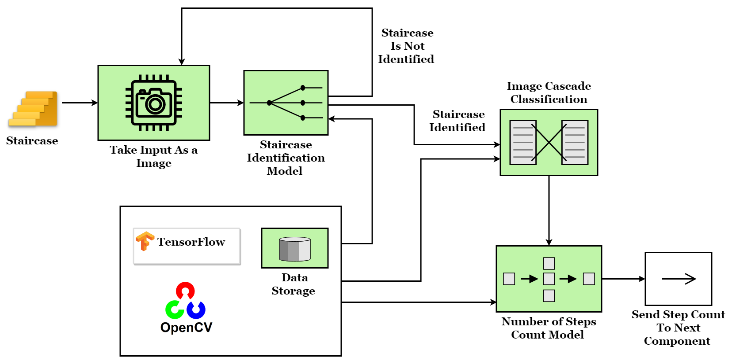
Methodology
System Overview Diagram

Slide 11
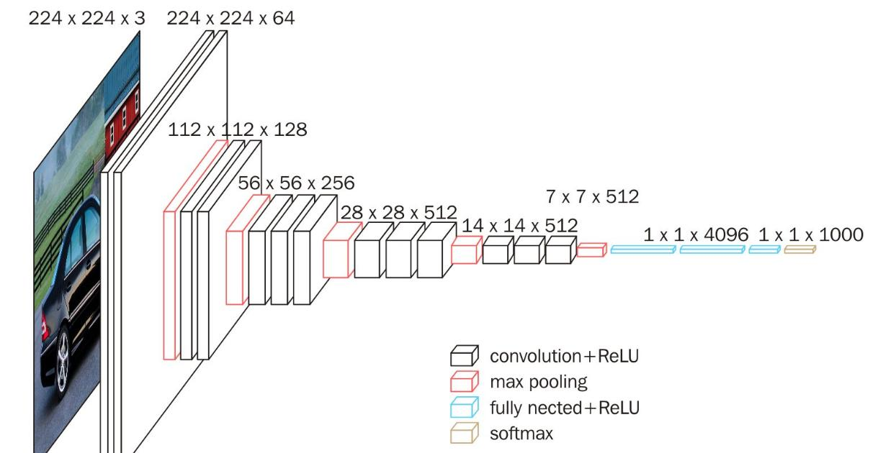



Methodology Cont...
Used technologies
Staircase Identification Model
VGG 16 – CNN model
TensorFlow
Image Cascade Classification Model
Staircase classification file
Number of Steps Count Model
OpenCV – (Probabilistic Hough Transform, Canny Edge Detection)
IDE
Google Colab.

Slide 12

Current Progress
Collected images of staircases and filtered them for get better accuracy.
Defined a model to identify staircase features.
Defined a model to identify number of steps in a staircase.
Defined a model to detect boundary lines of staircase

Slide 13
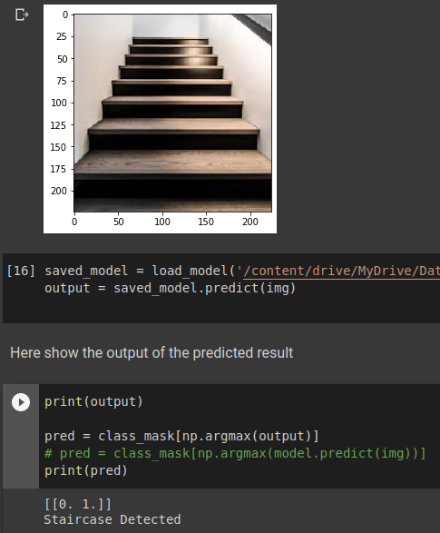
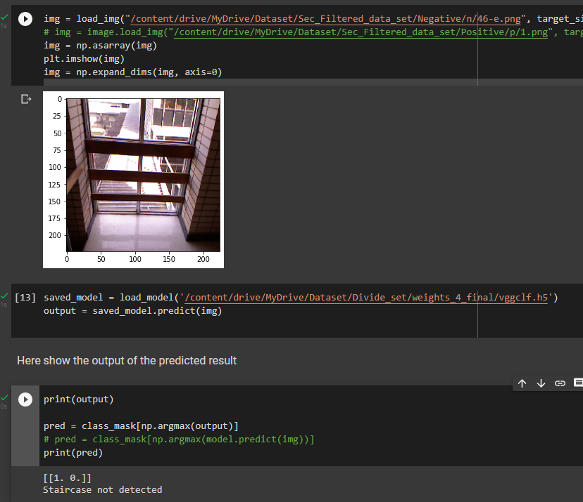
Evidences for the completion
Check output with positive image
Check output with negative image

Slide 14
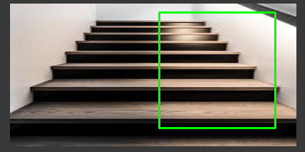
Evidences for the completion cont.…
Get Staircase Boundary Lines

Slide 15
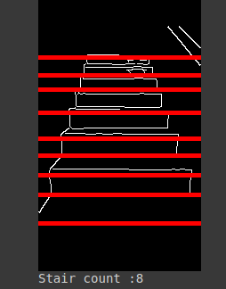
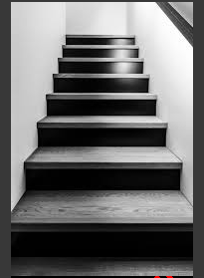

Evidences for the completion cont.…
Count number of steps on a staircase

Slide 16
Completion of the project
Working Plan
90%
Identify staircase
70%
Get number of steps have to climb
50%
Integrate robot camera to the detection system
70%
Staircase boundary line detection model

Slide 17

Completion of the project Cont.…
Future works
Consider how to integrate robot camera to the detection system.
How to identify low light situations?
How to increase brightness of image?
Improve staircase boundary line detection model.
Improve step counting model

Slide 18
References
Reference number | Reference
[1] | S. Oßwald, A. Görög, A. Hornung and M. Bennewitz, “Autonomous climbing of spiral staircases with humanoids,” 2011 IEEE/RSJ International Conference on Intelligent Robots and Systems, 2011, pp. 4844-4849, doi: 10.1109/IROS.2011.6094533.
[2] | W. Lu, “Design And Implementation of Autonomous Stair Climbing With NAO Humanoid Robot,” Master@Vaasa Univ. Appl. Sci., 2015.
[3] | A. Singh, S. Yadav and N. Singh, “Contrast enhancement and brightness preservation using global-local image enhancement techniques,” 2016 Fourth International Conference on Parallel, Distributed and Grid Computing (PDGC), 2016, pp. 291-294, doi: 10.1109/PDGC.2016.7913162.
[4] | D. S. Chan, R. K. Silva, J. C. Monteiro, and F. Lizarralde, “Efficient stairway detection and modeling for autonomous robot climbing,” IEEE Int. Conf. Intell. Robot. Syst., vol. 2017-Septe, pp. 5916–5921, 2017, doi: 10.1109/IROS.2017.8206485.
[5] | S. Mallick, "edge-detection-using-opencv," [Online]. Available: https://learnopencv.com/edge-detection-using-opencv/. [Accessed 28 November 2021].
[6] | H. Kinsley, "haar-cascade-object-detection-python-opencv-tutorial," 11 January 2016. [Online]. Available: https://pythonprogramming.net/haar-cascade-object-detection-python-opencv-tutorial/. [Accessed 04 December 2021]
[7] | Opencv.org, "Feature Detection - Probabilistic Hough transform," [Online]. Available: https://docs.opencv.org/3.4/dd/d1a/group__imgproc__feature.html#ga8618180a5948286384e3b7ca02f6feeb. [Accessed 13 December 2022]
[8] | J. Oheix, "From raw images to real-time predictions with Deep Learning," 7 January 2019. [Online]. Available: https://towardsdatascience.com/from-raw-images-to-real-time-predictions-with-deep-learning-ddbbda1be0e4. [Accessed 4 October 2021]

Slide 19

Demonstration

Slide 20

IT18217100 | Dilshan h.v.v
Specialization in Software Engineering

Slide 21
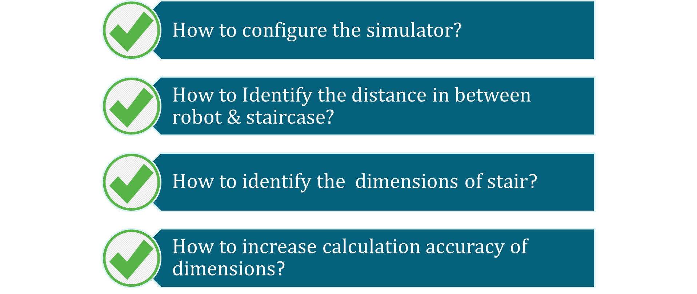
Research Question

Slide 22
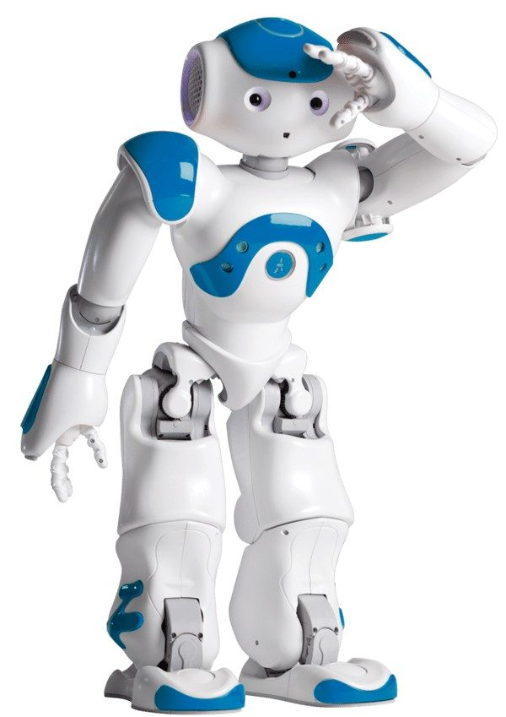
Specific and Sub Objectives
Specific Objectives
Configure the simulator
Get distance in between robot & staircase
Identify stair corners point
Get dimensions of stair
Sub Objectives
Consider how to integrate robot sensors to the defined dimensions system
Define a model to identify stair dimensions
Increase accuracy of dimensions calculation

Slide 23
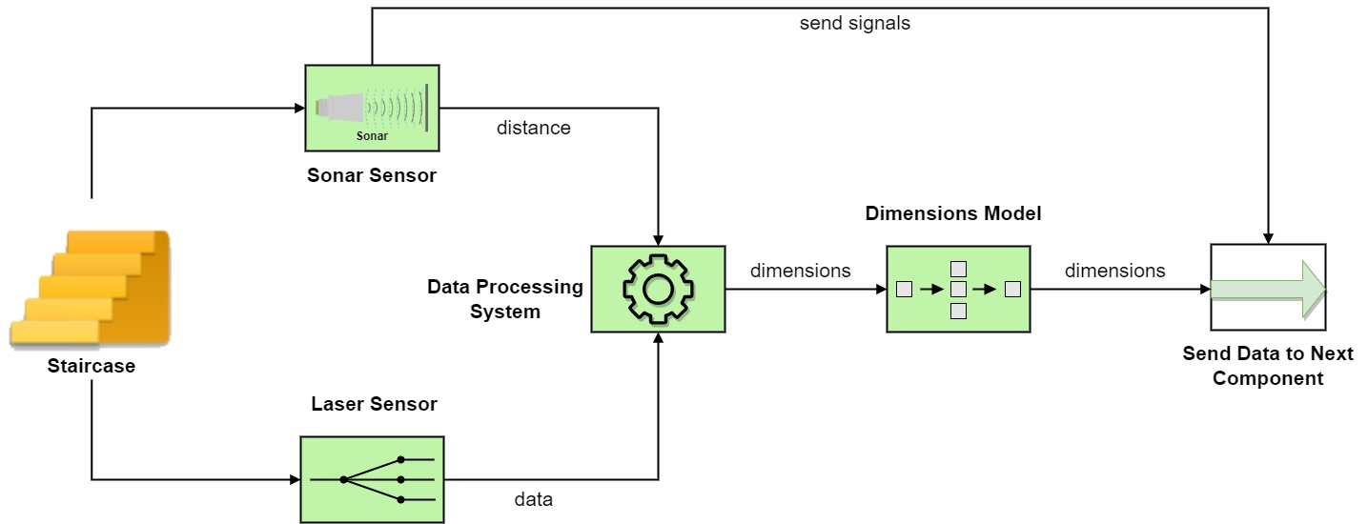
System Overview Diagram

Slide 24


Technologies
Used technologies
Simulation Softwares
Webots
Choregraphe
Robot
Nao Robot
Languages
Python

Slide 25
Current Progress
Configure Webots Simulator & Choregraphe
Configure Nao Robot into Webots
Create Staircase Object
Get distance in between robot & staircase

Slide 26
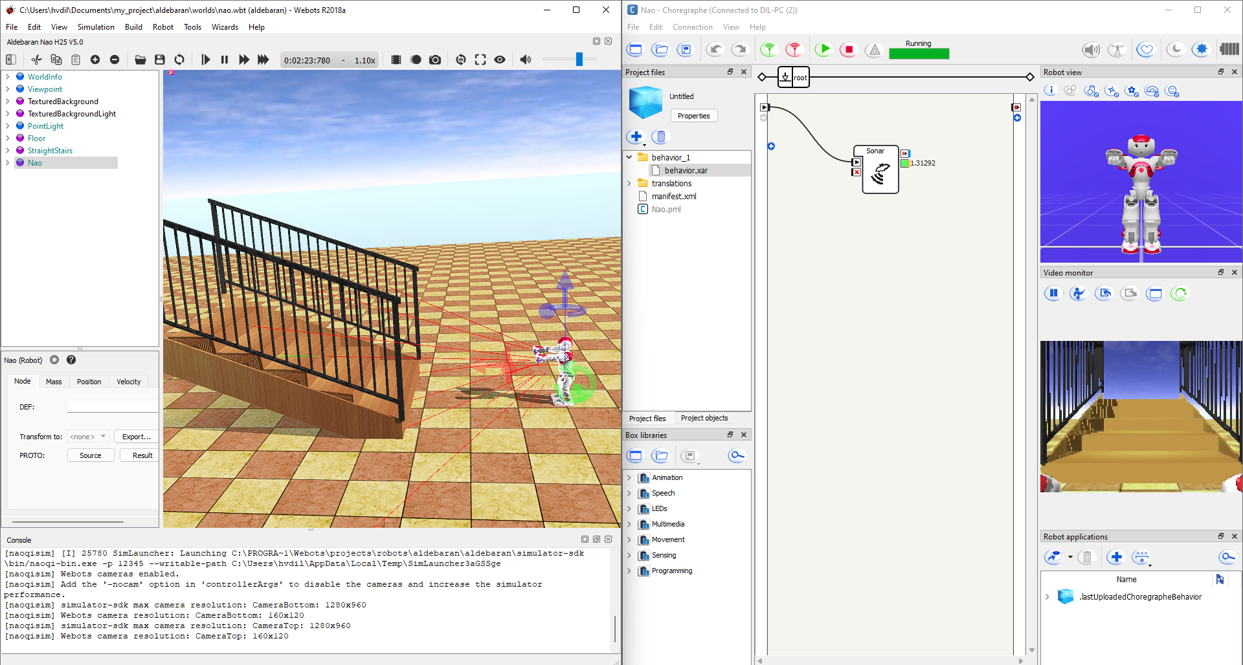

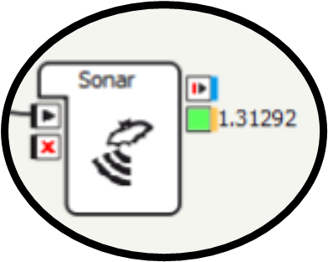
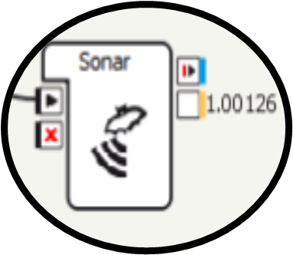
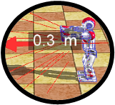
Evidences for the completion
Get distance in between robot & staircase using sonar sensor
Before change place | After moving near the staircase (0.3m)

Slide 27
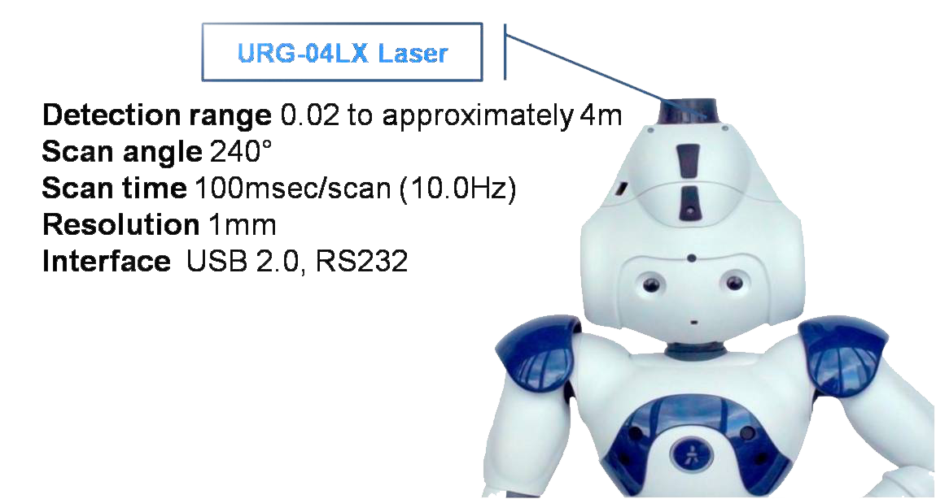
Future Works
Configure Nao laser head
Identify stair corners point
Gathering the stair data using laser sensor
Calculate dimensions of stair
Accurate dimensions calculations
Nao Laser Head

Slide 28
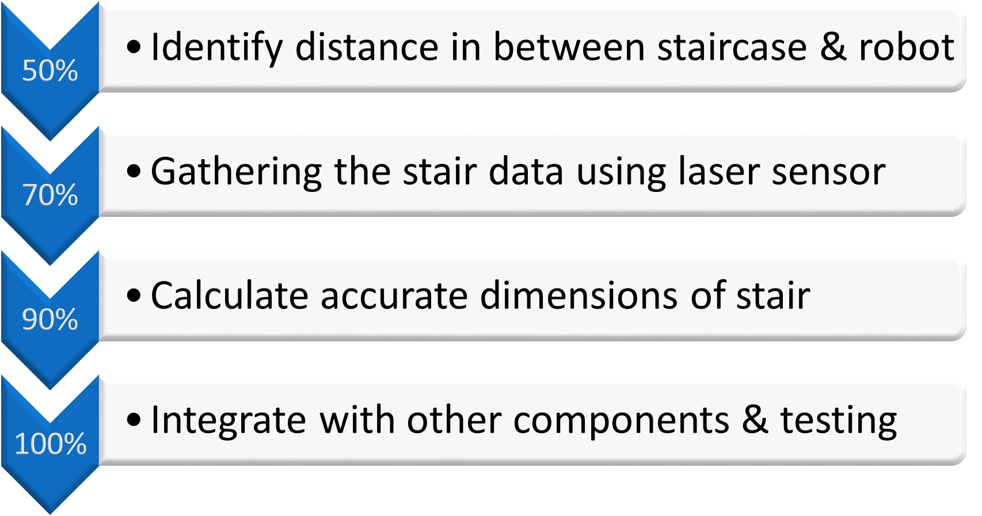
Working Plan

Slide 29
References
Reference number | Reference
[1] | E. Mihankhah, A. Kalantari, E. Aboosaeedan, H. D. Taghirad, S. Ali and A. Moosavian, “Autonomous staircase detection and stair climbing for a tracked mobile robot using fuzzy controller,” 2008 IEEE International Conference on Robotics and Biomimetics, 2009, pp. 1980-1985, doi: 10.1109/ROBIO.2009.4913304.
[2] | S. Oßwald, A. Görög, A. Hornung and M. Bennewitz, “Autonomous climbing of spiral staircases with humanoids,” 2011 IEEE/RSJ International Conference on Intelligent Robots and Systems, 2011, pp. 4844-4849, doi: 10.1109/IROS.2011.6094533.
[3] | Alam, Md Nakibul, Md Milon Islam, Md Ahsan Habib, and Motasim Billah Mredul. “Staircase detection systems for the visually impaired people: a review.” International Journal of Computer Science and Information Security (IJCSIS) 16, no. 12 (2018): 13-18.
[4] | Habib, Ahsan, Md Milon Islam, Muhammad Nomani Kabir, Motasim Billah Mredul, and Mahmudul Hasan. “Staircase Detection to Guide Visually Impaired People: A Hybrid Approach.” Rev. d’Intelligence Artif. 33, no. 5 (2019): 327-334.
[5] | W. Lu, “Design And Implementation of Autonomous Stair Climbing With NAO Humanoid Robot,” Master@Vaasa Univ. Appl. Sci., 2015.
[6] | J. Guo, P. Chen, Y. Jiang, H. Yokoi and S. Togo, “Real-time Object Detection with Deep Learning for Robot Vision on Mixed Reality Device,” 2021 IEEE 3rd Global Conference on Life Sciences and Technologies (LifeTech), 2021, pp. 82-83, doi: 10.1109/LifeTech52111.2021.9391811.
[7] | J. FOURRE, V. VAUCHEY, Y. DUPUIS and X. SAVATIER, “Autonomous RGBD-based Industrial Staircase Localization from Tracked Robots,” 2020 IEEE/RSJ International Conference on Intelligent Robots and Systems (IROS), 2020, pp. 10691-10696, doi: 10.1109/IROS45743.2020.9340941.
[8] | A. Singh, S. Yadav and N. Singh, “Contrast enhancement and brightness preservation using global-local image enhancement techniques,” 2016 Fourth International Conference on Parallel, Distributed and Grid Computing (PDGC), 2016, pp. 291-294, doi: 10.1109/PDGC.2016.7913162.
[9] | A. Ma’arif, A. A. Nuryono and Iswanto, “Vision-Based Line Following Robot in Webots,” 2020 FORTEI-International Conference on Electrical Engineering (FORTEI-ICEE), 2020, pp. 24-28, doi: 10.1109/FORTEI-ICEE50915.2020.9249943.
[10] | D. Aguilera-Castro, M. Neira-Cárcamo, C. Aguilera-Carrasco and L. Vera-Quiroga, “Stairs recognition using stereo vision-based algorithm in NAO robot,” 2017 CHILEAN Conference on Electrical, Electronics Engineering, Information and Communication Technologies (CHILECON), 2017, pp. 1-6, doi: 10.1109/CHILECON.2017.8229674.

Slide 30
Demonstration

Slide 31

IT18220834 | Wijethilaka R.G.K.H
Specialization in Information Technology

Slide 32
Research Question
How to move robot with legs?
How to manage weight between legs?
How to correctly move between steps and how to manage distance between legs?
How to control speed between legs?

Slide 33
Specific and Sub Objectives
Specific Objectives
Move robot’s legs on staircases
Sub Objectives
How to move ankle, knee and hip.
How to manage weight between moving legs.
How to manage swing in the right direction legs
How to manage speed of legs

Slide 34
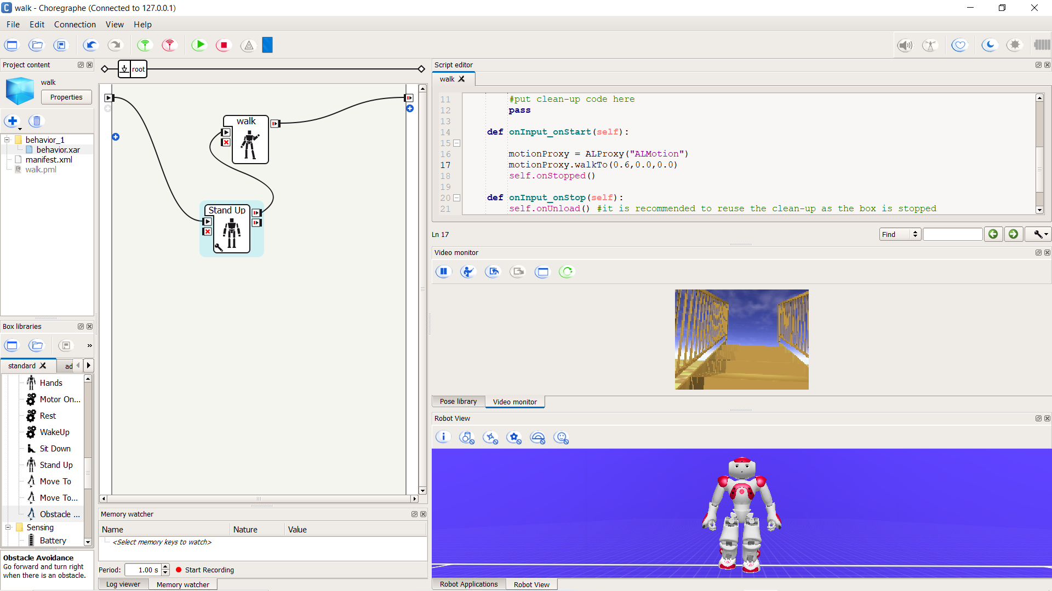

Evidences for the completion

Slide 35
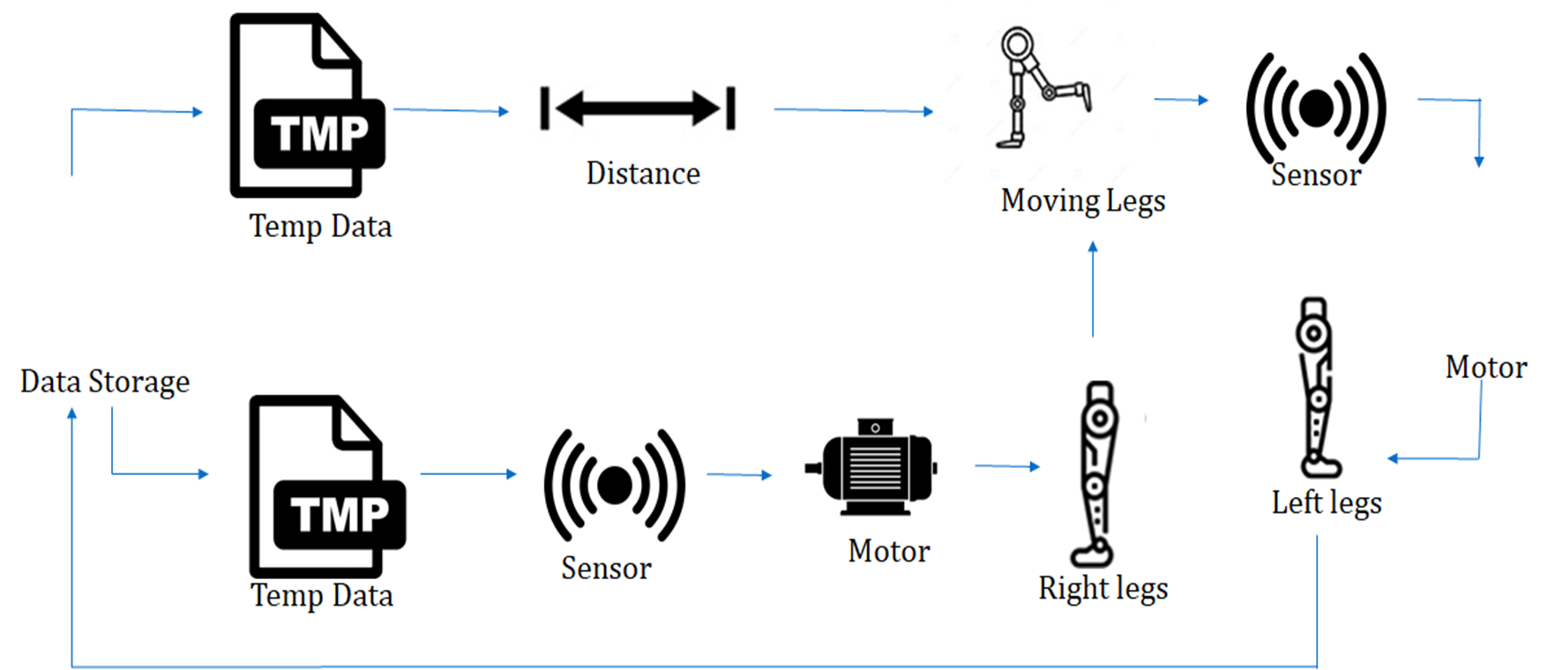


Methodology
System Overview Diagram

Slide 36
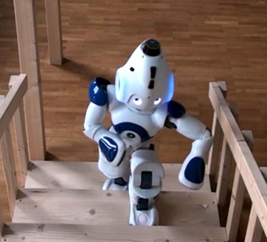
Technologies
Programming Language(Algorithms)
Python
Technologies and Software
Motion Sensors
- Motion sensor use move legs
Webots
Choregraphe

Slide 37
Completion of the project
Configure Webots Simulator & Choregraphe
Configure Nao Robot into Webots
Create to walking pattern using python

Slide 38
Working Plan
50%
How to move robot using walking pattern
70%
How to balance between legs
100%
Integrate with other component and testing
90%
How to climb staircases using pattern

Slide 39
Future Works
How to balance between legs to climb object
How to climb staircases using pattern ​
​

Slide 40
References
Reference number | Reference
[1] | E. Mihankhah, A. Kalantari, E. Aboosaeedan, H. D. Taghirad, S. Ali and A. Moosavian, “Autonomous staircase detection and stair climbing for a tracked mobile robot using fuzzy controller,” 2008 IEEE International Conference on Robotics and Biomimetics, 2009, pp. 1980-1985, doi: 10.1109/ROBIO.2009.4913304.
[2] | S. Oßwald, A. Görög, A. Hornung and M. Bennewitz, “Autonomous climbing of spiral staircases with humanoids,” 2011 IEEE/RSJ International Conference on Intelligent Robots and Systems, 2011, pp. 4844-4849, doi: 10.1109/IROS.2011.6094533.
[3] | Alam, Md Nakibul, Md Milon Islam, Md Ahsan Habib, and Motasim Billah Mredul. “Staircase detection systems for the visually impaired people: a review.” International Journal of Computer Science and Information Security (IJCSIS) 16, no. 12 (2018): 13-18.
[4] | Habib, Ahsan, Md Milon Islam, Muhammad Nomani Kabir, Motasim Billah Mredul, and Mahmudul Hasan. “Staircase Detection to Guide Visually Impaired People: A Hybrid Approach.” Rev. d’Intelligence Artif. 33, no. 5 (2019): 327-334.
[5] | W. Lu, “Design And Implementation of Autonomous Stair Climbing With NAO Humanoid Robot,” Master@Vaasa Univ. Appl. Sci., 2015.
[6] | J. Guo, P. Chen, Y. Jiang, H. Yokoi and S. Togo, “Real-time Object Detection with Deep Learning for Robot Vision on Mixed Reality Device,” 2021 IEEE 3rd Global Conference on Life Sciences and Technologies (LifeTech), 2021, pp. 82-83, doi: 10.1109/LifeTech52111.2021.9391811.
[7] | J. FOURRE, V. VAUCHEY, Y. DUPUIS and X. SAVATIER, “Autonomous RGBD-based Industrial Staircase Localization from Tracked Robots,” 2020 IEEE/RSJ International Conference on Intelligent Robots and Systems (IROS), 2020, pp. 10691-10696, doi: 10.1109/IROS45743.2020.9340941.
[8] | A. Singh, S. Yadav and N. Singh, “Contrast enhancement and brightness preservation using global-local image enhancement techniques,” 2016 Fourth International Conference on Parallel, Distributed and Grid Computing (PDGC), 2016, pp. 291-294, doi: 10.1109/PDGC.2016.7913162.
[9] | A. Ma’arif, A. A. Nuryono and Iswanto, “Vision-Based Line Following Robot in Webots,” 2020 FORTEI-International Conference on Electrical Engineering (FORTEI-ICEE), 2020, pp. 24-28, doi: 10.1109/FORTEI-ICEE50915.2020.9249943.
[10] | D. Aguilera-Castro, M. Neira-Cárcamo, C. Aguilera-Carrasco and L. Vera-Quiroga, “Stairs recognition using stereo vision-based algorithm in NAO robot,” 2017 CHILEAN Conference on Electrical, Electronics Engineering, Information and Communication Technologies (CHILECON), 2017, pp. 1-6, doi: 10.1109/CHILECON.2017.8229674.

Slide 41
Demonstration

Slide 42

IT18212150 | Balasooriya T.D
Specialization in Information Technology

Slide 43
Research Question
When it starts to walk and climb stairs control it’s stability is the main part
How to convert human motion to mechanical property?
How to maintain stability while moving

Slide 44
Specific and Sub Objectives
Specific Objectives
Maintain Stability when moving
Maintain Balance while climbing stairs
Sub Objectives
Detect supportive leg
Implement a controller design
Analyze mechanical properties of human walking
Get feedback of walking and optimize the movement

Slide 45
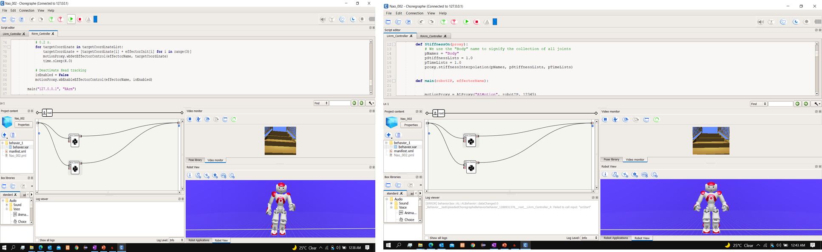
Evidences for the completion

Slide 46
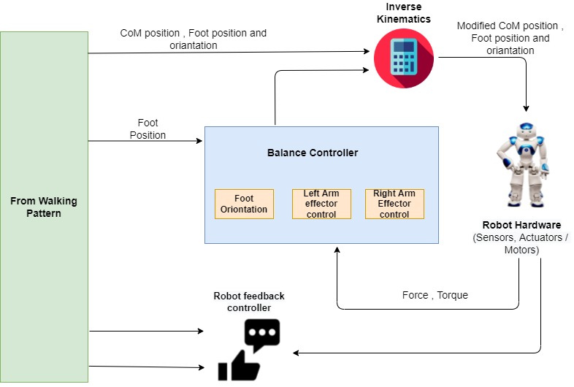
Methodology
System Overview Diagram

Slide 47
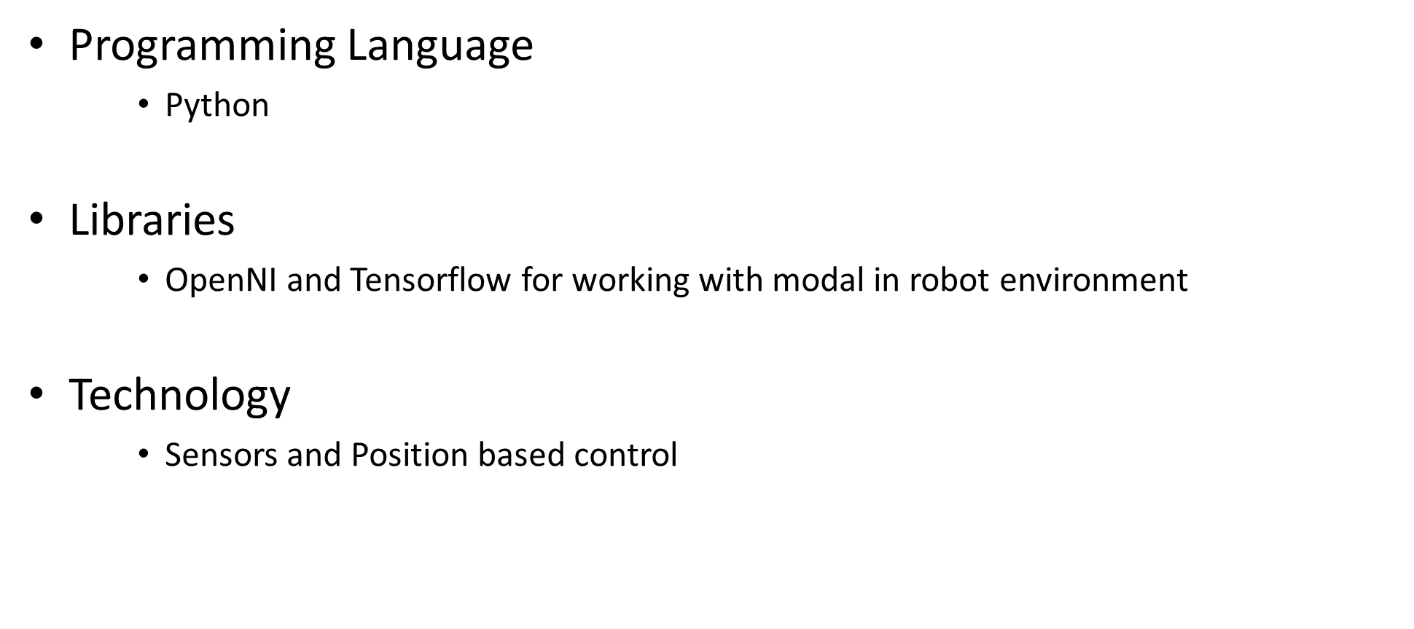
Technologies

Slide 48
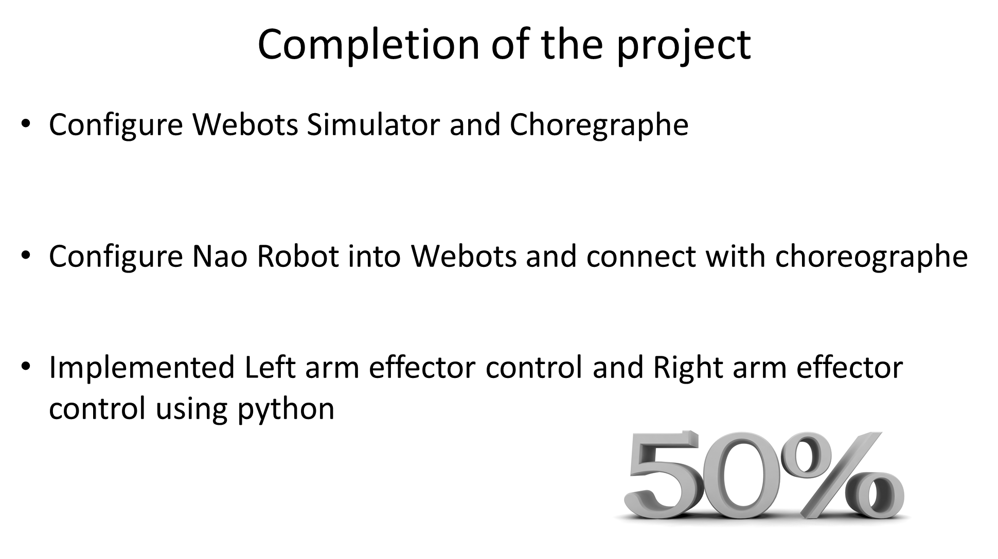

Slide 49
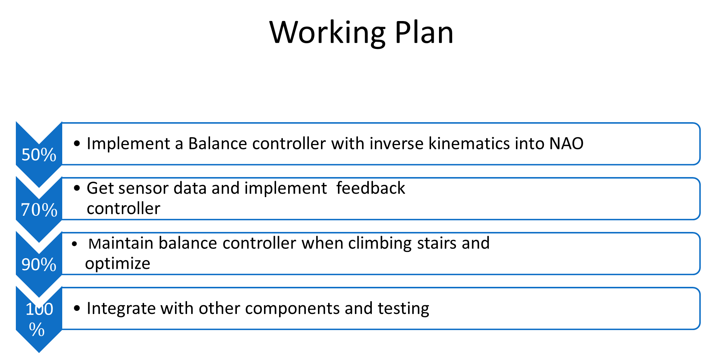

Slide 50
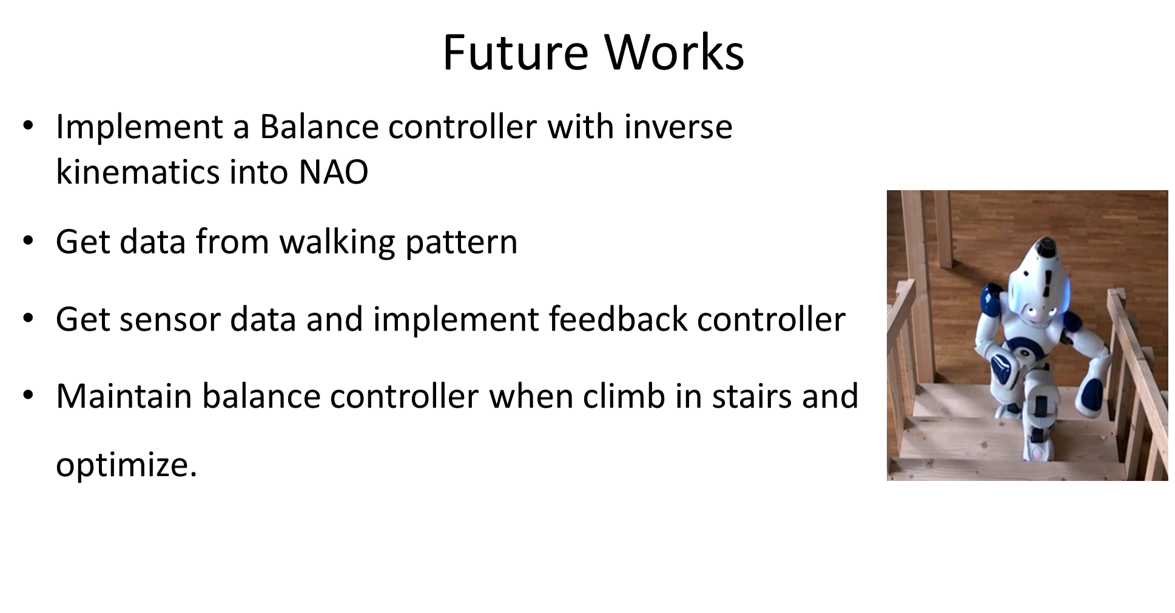

Slide 51
References
Reference number | Reference
[1] | E. Mihankhah, A. Kalantari, E. Aboosaeedan, H. D. Taghirad, S. Ali and A. Moosavian, “Autonomous staircase detection and stair climbing for a tracked mobile robot using fuzzy controller,” 2008 IEEE International Conference on Robotics and Biomimetics, 2009, pp. 1980-1985, doi: 10.1109/ROBIO.2009.4913304.
[2] | S. Oßwald, A. Görög, A. Hornung and M. Bennewitz, “Autonomous climbing of spiral staircases with humanoids,” 2011 IEEE/RSJ International Conference on Intelligent Robots and Systems, 2011, pp. 4844-4849, doi: 10.1109/IROS.2011.6094533.
[3] | Alam, Md Nakibul, Md Milon Islam, Md Ahsan Habib, and Motasim Billah Mredul. “Staircase detection systems for the visually impaired people: a review.” International Journal of Computer Science and Information Security (IJCSIS) 16, no. 12 (2018): 13-18.
[4] | Habib, Ahsan, Md Milon Islam, Muhammad Nomani Kabir, Motasim Billah Mredul, and Mahmudul Hasan. “Staircase Detection to Guide Visually Impaired People: A Hybrid Approach.” Rev. d’Intelligence Artif. 33, no. 5 (2019): 327-334.
[5] | W. Lu, “Design And Implementation of Autonomous Stair Climbing With NAO Humanoid Robot,” Master@Vaasa Univ. Appl. Sci., 2015.
[6] | J. Guo, P. Chen, Y. Jiang, H. Yokoi and S. Togo, “Real-time Object Detection with Deep Learning for Robot Vision on Mixed Reality Device,” 2021 IEEE 3rd Global Conference on Life Sciences and Technologies (LifeTech), 2021, pp. 82-83, doi: 10.1109/LifeTech52111.2021.9391811.
[7] | J. FOURRE, V. VAUCHEY, Y. DUPUIS and X. SAVATIER, “Autonomous RGBD-based Industrial Staircase Localization from Tracked Robots,” 2020 IEEE/RSJ International Conference on Intelligent Robots and Systems (IROS), 2020, pp. 10691-10696, doi: 10.1109/IROS45743.2020.9340941.
[8] | A. Singh, S. Yadav and N. Singh, “Contrast enhancement and brightness preservation using global-local image enhancement techniques,” 2016 Fourth International Conference on Parallel, Distributed and Grid Computing (PDGC), 2016, pp. 291-294, doi: 10.1109/PDGC.2016.7913162.
[9] | A. Ma’arif, A. A. Nuryono and Iswanto, “Vision-Based Line Following Robot in Webots,” 2020 FORTEI-International Conference on Electrical Engineering (FORTEI-ICEE), 2020, pp. 24-28, doi: 10.1109/FORTEI-ICEE50915.2020.9249943.
[10] | D. Aguilera-Castro, M. Neira-Cárcamo, C. Aguilera-Carrasco and L. Vera-Quiroga, “Stairs recognition using stereo vision-based algorithm in NAO robot,” 2017 CHILEAN Conference on Electrical, Electronics Engineering, Information and Communication Technologies (CHILECON), 2017, pp. 1-6, doi: 10.1109/CHILECON.2017.8229674.

Slide 52
Demonstration

